Slide 1

19CS2211 - Software Engineering
White-Box Testing,
Validation Testing, System Testing
Session 22

Slide 2

White-box Testing
Called glass-box testing
Used in control structure
guarantee that all independent paths within a module have been exercised at least once
exercise all logical decisions on their true and false sides
execute all loops at their boundaries and within their operational bounds
exercise internal data structures to ensure their validity

Slide 3
White-box Testing
Basis path testing
Flow Graph Notation
Independent program paths
Deriving Basis sets and test cases
Graph Matrices

Slide 4
Basis Path Testing
White-box testing technique proposed by Tom McCabe
Enables the test case designer to derive a logical complexity measure of a procedural design.
Uses this measure as a guide for defining a basis set of execution paths
Test cases derived to exercise the basis set are guaranteed to execute every statement in the program at least one time during testing

Slide 5
Flow Graph Notation
A circle in a graph represents a node, which stands for a sequence of one or more procedural statements
A node containing a simple conditional expression is referred to as a predicate node
Each compound condition in a conditional expression containing one or more Boolean operators (e.g., and, or) is represented by a separate predicate node
A predicate node has two edges leading out from it (True and False)
An edge, or a link, is a an arrow representing flow of control in a specific direction
An edge must start and terminate at a node
An edge does not intersect or cross over another edge
Areas bounded by a set of edges and nodes are called regions
When counting regions, include the area outside the graph as a region, too

Slide 6
Flow Graph Example
FLOW CHART
FLOW GRAPH
0
0
R4
1
1
2
2
3
R3
3
6
4
6
4
R2
7
8
5
R1
7
8
5
9
9
11
10
11
10
Notes:
0-1-11
0-1—2-3-6-7-9-10-1-11
0-1-2-3-6-8-9-10-1-11
0-1-2-3-4-5-10-1-11

Slide 7
Independent Program Paths
Defined as a path through the program from the start node until the end node that introduces at least one new set of processing statements or a new condition (i.e., new nodes)
Must move along at least one edge that has not been traversed before by a previous path
Basis set for flow graph on previous slide
Path 1: 0-1-11
Path 2: 0-1-2-3-4-5-10-1-11
Path 3: 0-1-2-3-6-8-9-10-1-11
Path 4: 0-1-2-3-6-7-9-10-1-11
The number of paths in the basis set is determined by the cyclomatic complexity

Slide 8
Cyclomatic Complexity
Provides a quantitative measure of the logical complexity of a program
Defines the number of independent paths in the basis set
Provides an upper bound for the number of tests that must be conducted to ensure all statements have been executed at least once
Can be computed three ways
The number of regions
V(G) = E – N + 2, where E is the number of edges and N is the number of nodes in graph G
V(G) = P + 1, where P is the number of predicate nodes in the flow graph G
Results in the following equations for the example flow graph
Number of regions = 4
V(G) = 14 edges – 12 nodes + 2 = 4
V(G) = 3 predicate nodes + 1 = 4

Slide 9
Deriving the Basis Set and Test Cases
Using the design or code as a foundation, draw a corresponding flow graph
Determine the cyclomatic complexity of the resultant flow graph
Determine a basis set of linearly independent paths
Prepare test cases that will force execution of each path in the basis set

Slide 10
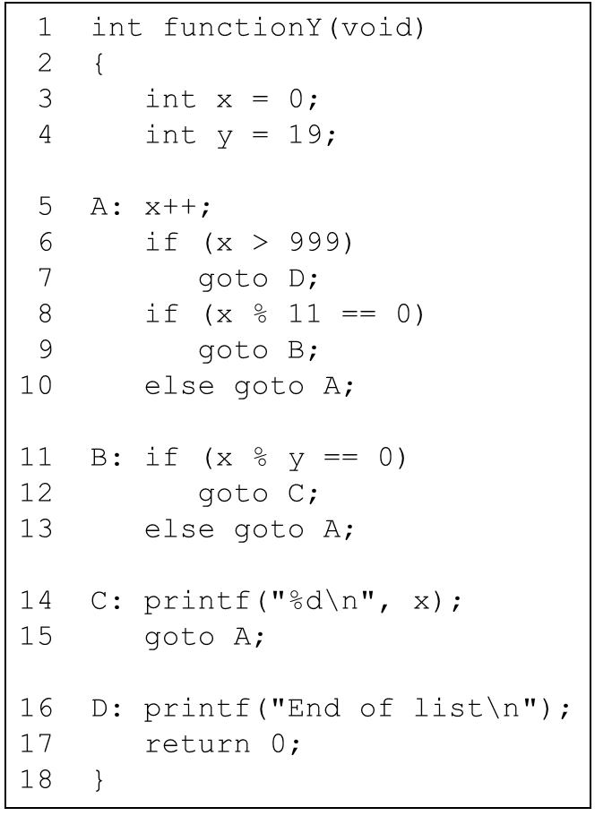

Slide 11
A Second Flow Graph Example
3
1 int functionY(void)
2 {
3 int x = 0;
4 int y = 19;
5 A: x++;
6 if (x > 999)
7 goto D;
8 if (x % 11 == 0)
9 goto B;
10 else goto A;
11 B: if (x % y == 0)
12 goto C;
13 else goto A;
14 C: printf("%d\n", x);
15 goto A;
16 D: printf("End of list\n");
17 return 0;
18 }
4
5
6
8
7
10
9
16
11
17
13
12
14
15

Slide 12
A Sample Function to Diagram and Analyze
1 int functionZ(int y)
2 {
3 int x = 0;
4 while (x <= (y * y))
5 {
6 if ((x % 11 == 0) &&
7 (x % y == 0))
8 {
9 printf(“%d”, x);
10 x++;
11 } // End if
12 else if ((x % 7 == 0) ||
13 (x % y == 1))
14 {
15 printf(“%d”, y);
16 x = x + 2;
} // End else
18 printf(“\n”);
19 } // End while
20 printf("End of list\n");
21 return 0;
22 } // End functionZ

Slide 13
A Sample Function to Diagram and Analyze
1 int functionZ(int y)
2 {
3 int x = 0;
4 while (x <= (y * y))
5 {
6 if ((x % 11 == 0) &&
7 (x % y == 0))
8 {
9 printf(“%d”, x);
10 x++;
11 } // End if
12 else if ((x % 7 == 0) ||
13 (x % y == 1))
14 {
15 printf(“%d”, y);
16 x = x + 2;
} // End else
18 printf(“\n”);
19 } // End while
20 printf("End of list\n");
21 return 0;
22 } // End functionZ
3
4
6
7
9
12
13
10
15
16
18
20
21

Slide 14
Graph Matrices
A graph matrix is a square matrix whose size (i.e., number of rows and columns) is equal to the number of nodes on a flow graph.
Each row and column corresponds to an identified node, and matrix entries correspond to connections (an edge) between nodes.
By adding a link weight to each matrix entry, the graph matrix can become a powerful tool for evaluating program control structure during testing

Slide 15
Graph Matrices
Connected to node
1
Node
1
2
3
4
5
a
3
1
 |  | a
 | d |  | b
 | c |  |  | f
 | g | e
e
2
b
5
4
3
d
f
4
c
g
5
2

Slide 16
Validation Testing
It begins at the culmination of integration testing
When individual components have been exercised, the software is completely assembled as a package, and interfacing errors have been uncovered and corrected.
At the validation or system level, the distinction between conventional software, object-oriented software, and WebApps disappears.
Testing focuses on user-visible actions and user-recognizable output from the system.

Slide 17
Validation Criteria:
After each validation test case has been conducted, one of two possible conditions exists:
The function or performance characteristic conforms to specification and is accepted or
a deviation from specification is uncovered and a deficiency list is created.
Note:
Deviations or errors discovered at this stage in a project can rarely be corrected prior to scheduled delivery.

Slide 18
Configuration Review:
To ensure that all elements of the software configuration have been properly developed, are cataloged, and have the necessary detail to bolster the support activities.

Slide 19
Alpha and Beta Testing
The alpha test:
Conducted at the developer’s site
Developer should present
Used in a natural setting with the developer “looking over the shoulder” of the users and recording errors and usage problems.
The beta test:
Conducted at one or more end-user sites.
Developer generally is not present.
Therefore, the beta test is a “live” application of the software in an environment that cannot be controlled by the developer.

Slide 20
A variation on beta testing, called customer acceptance testing:
Performed when software is delivered to a customer under contract.
The customer performs a series of specific tests in an attempt to uncover errors before accepting the software from the developer.

Slide 21
System Testing
Series of different tests whose primary purpose is to fully exercise the computer-based system.
Purpose - to verify that system elements have been properly integrated and perform allocated functions.

Slide 22
Recovery Testing:
It is a system test
It forces the software to fail in a variety of ways and verifies that recovery is properly performed.
If recovery is automatic (performed by the system itself), re-initialization, check pointing mechanisms, data recovery, and restart are evaluated for correctness.
Security Testing:
Protect the system from improper penetration.

Slide 23
Stress Testing:
Executes a system – with resources in abnormal quantity, frequency, or volume.
A variation of stress testing is a technique called sensitivity testing.
Sensitivity testing - to uncover data combinations within valid input classes that may cause instability or improper processing.

Slide 24
Performance Testing:
To test the run-time performance of software within the context of an integrated system.
Performance testing occurs throughout all steps in the testing process. Performance tests are often coupled with stress testing
It require both hardware and software instrumentation.

Slide 25
Deployment Testing:
Called configuration testing
Exercises the software in each environment in which it is to operate
Examines all installation procedures and specialized installation software (e.g., “installers”) that will be used by customers
All documentation that will be used to introduce the software to end users

Slide 26
Revision Questions
Define System Testing.
2. Outline the types of System testing.
Explain behavioral testing that make use of graphs.
Distinguish White Box and Black Box Testing.
Distinguish Validation Testing and Black Box Testing.
Distinguish Performance Testing and Deployment Testing.

Slide 27
Thank You

